Slide 1
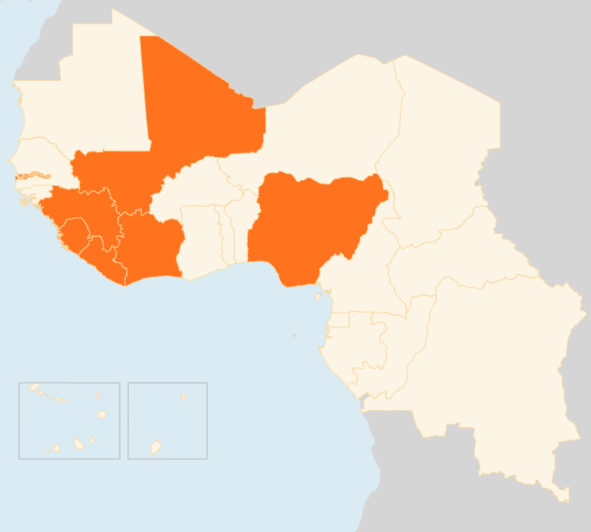

10 – 16 Mar 2015
COTE D’IVOIRE
475 DISPLACED IN INTER-COMMUNITY VIOLENCE
On 9 March, violent confrontation between Baoulé and Burkinabé communities in Côte d’Ivoire’s south-western Goin Débé forest displaced 475 people, left one person dead and 15 injured. The Ivorian Red Cross and local authorities are providing assistance. Tensions are likely to escalate between the two communities especially with the resumption of the voluntary repatriation of Ivorian refugees from neighbouring Liberia.
NIGERIA
ARMY VOWS TO RETAKE MORE TOWNS
Nigeria’s army announced intensifying battles to retake more areas held by Boko Haram. It said Gwoza Local Government Area in Borno State, and Goneri and Gujba in Yobe State were the only towns yet to be cleared of the militants. Around 1.2 million people have been displaced within Nigeria mainly by the violence. Meanwhile, the Electoral Commission announced that presidential and legislative elections rescheduled to 28 March for security reasons will go on as planned.
MALI
REBEL GROUPS REJECT PEACE DEAL
Northern Mali rebel groups have rejected the 1 March Algiers peace accord saying it “will not bring peace.” The Coordination of Azawad Movements which also includes the main National Movement for the Liberation of Azawad made the decision after consulting their grassroots. But they indicated willingness for further dialogue with the government to find a suitable outcome. Mali is still plagued by persistent insecurity, especially the vast northern region, making humanitarian operations difficult.
REGIONAL / EBOLA VIRUS DISEASE (EVD):
OVER 10,000 KILLED BY EBOLA
Ebola has now claimed the lives of 10,004 people and infected 24,350 others in the three West African countries worst-hit by the virus. Infection rates have nonetheless dropped significantly in recent months, with Liberia reporting no new cases for the third consecutive week. Guinea and Sierra Leone reported 58 confirmed cases each as of 8 March. The infections are mostly occurring in and around the capital cities of the two countries.
1.2 MILLION FACE FOOD CRISIS
According to a recent CILSS report, at least 1.2 million people are estimated to be in Phase 3 (crisis) food insecurity and require immediate assistance to protect livelihoods and prevent malnutrition mainly in two regions of Sierra Leone (Port Loko and Bombali districts). Around 3.9 million others are currently in Phase 2 (stress) in Guinea, Liberia and Sierra Leone due to the impact of EVD on farming, trade and livelihoods.
MALI
CMA REBELS REJECT PEACE DEAL
NIGERIA
ARMY VOWS TO RETAKE MORE TOWNS
COTE D’IVOIRE
475
DISPLACED BY VIOLENCE
LIBERIA
REGIONAL / EVD
0
EVD CASES FOR THIRD WEEK
10k
KILLED BY EBOLA
1.2
MILLION FACE FOOD CRISIS
Creation date: 17 March 2014
Map data sources: UNCS, DevInfo, OCHA.
The boundaries and names shown and the designations used on this map do not imply official endorsement or acceptance by the United Nations

